Slide 1
Unit 203: Electrical installations technology
Micro-renewable energies

Slide 2
Micro-renewable energies
Most of these are relatively new technologies and it is important to determine the specific requirements for each one. These requirements include:
legal
regulatory
building location
building fabric.

Slide 3
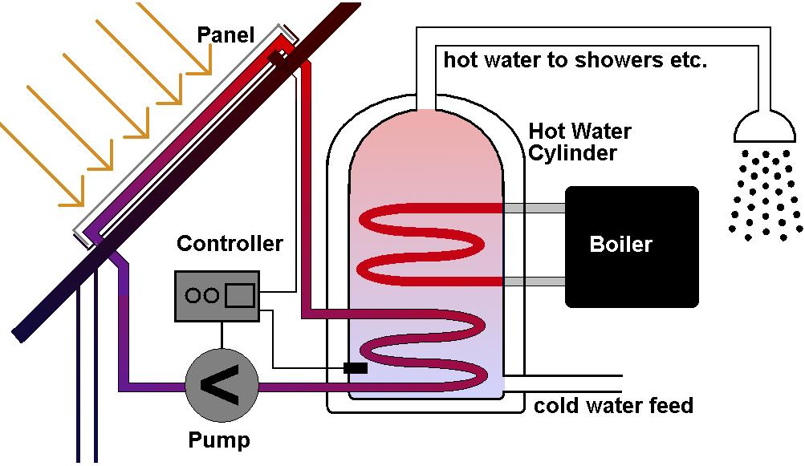
Micro-renewable energies
Solar thermal (hot water)

Slide 4
Micro-renewable energies
Solar thermal (hot water)
Benefits
It should work all year round during the day but consumers will probably need to heat the water further in winter months, using a boiler or immersion heater.
It can save on fuel bills.
It should be eligible for renewable heat incentives.
It can cost a lot less to install than other micro-generation technologies.
It does not cost more than £5,000.

Slide 5
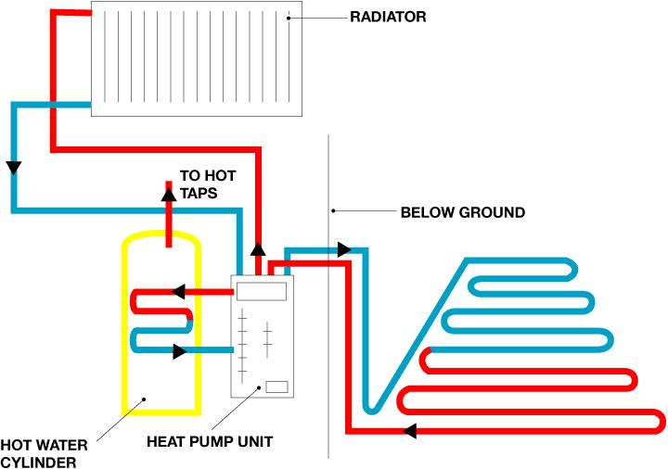
Micro-renewable energies
Ground source heat pump (GSHP)

Slide 6
Micro-renewable energies
Ground source heat pump (GSHP)
Benefits
It could lower fuel bills, especially if replacing conventional electric heating.
It could provide an income through the government’s Renewable Heat Incentive (RHI).
It could lower the premises’ carbon emissions, depending on which fuel is being replaced.
It doesn’t need fuel deliveries.
It can heat the premises and provide hot water.
It needs little maintenance – they are called ‘fit and forget’ technology.

Slide 7
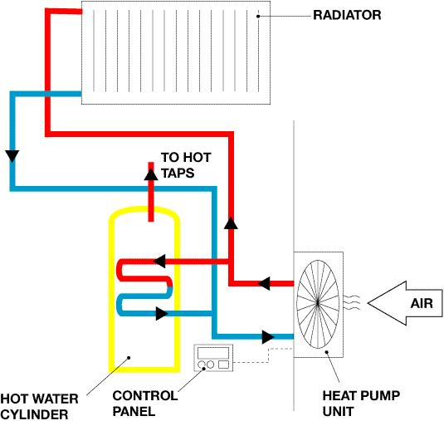
Micro-renewable energies
Air source heat pump (ASHP)

Slide 8
Micro-renewable energies
Air source heat pump (ASHP)
Benefits
It could lower fuel bills, especially if replacing conventional electric heating.
It could provide an income through the government’s Renewable Heat Incentive (RHI).
It could lower the premises’ carbon emissions, depending on which fuel is being replaced.
It doesn’t need fuel deliveries.
It can heat the home and provide hot water.
It need little maintenance – they are called ‘fit and forget’ technology.
It can be easier to install than a ground source heat pump, though efficiencies may be lower.

Slide 9
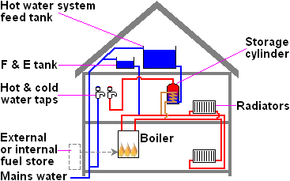
Micro-renewable energies
Wood-fuelled heating

Slide 10
Micro-renewable energies
Wood-fuelled heating
Benefits
Affordable heating fuel: although the price of wood fuel varies considerably, it is often cheaper than other heating options.
Financial support: wood-fuelled boiler systems could benefit from the Renewable Heat Premium Payment and the Renewable Heat Incentive (RHI).
A low-carbon option: the carbon dioxide emitted when wood is burned is the same amount that was absorbed over the months and years during which the plant was growing. The process is sustainable, as long as new plants continue to grow in place of those used for fuel. There are some carbon emissions caused by the cultivation, manufacture and transportation of the fuel but, as long as the fuel is sourced locally, these are much lower than the emissions from fossil fuels.

Slide 11
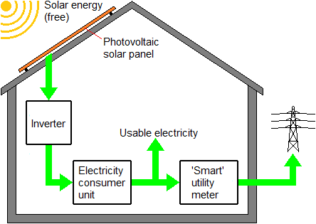
Micro-renewable energies
Photo-voltaic (PV)

Slide 12
Micro-renewable energies
Photo-voltaic (PV)
Benefits
Sunlight is free so, after the initial installation, electricity costs will be reduced.
The government’s feed-in tariffs pay the consumer for electricity generated, even if they use it.
If the system is producing more electricity than needed by the consumer, or when they can’t use it, the surplus can be sold back to the Grid.
You will cut your carbon footprint. Solar electricity is green, renewable energy and doesn’t release any harmful carbon dioxide or other pollutants. A typical home solar PV system could save over a tonne of carbon dioxide per year – that’s more than 30 tonnes over its lifetime.

Slide 13
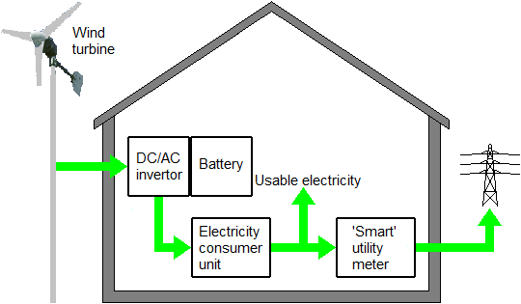
Micro-renewable energies
Micro-wind

Slide 14
Micro-renewable energies
Micro-wind
For building-mounted turbines, the criteria include:
the house is detached
the top of the turbine blades is no more than three metres above the top of the house, or 15 metres above the ground
all of the turbine is at least five metres from the edge of the householder’s property.
For pole-mounted turbines, the criteria include:
the top of the turbine is no more than 11.1 metres above ground
all of the turbine is at least 1.1 times the height of the turbine away from the edge of the householder’s property.

Slide 15
Micro-renewable energies
Micro-wind
And for both types of turbine:
there is no other wind turbine and no air source heat pump on the site
the bottom of the blades is at least five metres above ground
the turbine’s swept area is no more than 3.8m²
the site is not on land safeguarded for aviation or defence purpose.

Slide 16
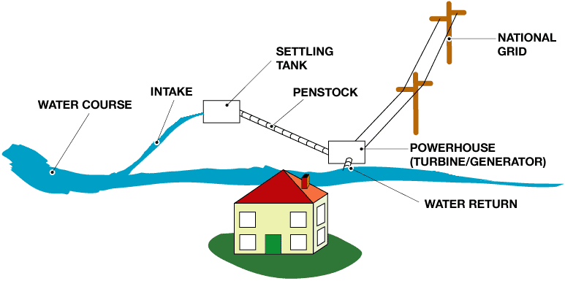
Micro-renewable energies
Micro-hydro

Slide 17
Micro-renewable energies
Micro-hydro
Benefits
A hydro system can generate 24 hours a day, often generating all the electricity the consumer needs and more.
If eligible, the consumer will get payments from the feed-in tariff for all the electricity generated, as well as for any surplus electricity sold back to the Grid.
A hydro system may generate more electricity than needed for lighting the home and powering the electrical appliances – so the excess electricity can be used to heat the home and hot water too.
Installing a hydro system can be expensive but in many cases it’s less than the cost of getting a connection to the National Grid if the premises do not already have one.
Hydroelectricity is green, renewable energy and doesn’t release any harmful carbon dioxide or other pollutants.

Slide 18
Micro-renewable energies
Micro-hydro
In order to be suitable for electricity generation, a river needs to have a combination of:
flow – how much water is flowing down the river per second, and
head – a difference in height over a reasonably short distance.

Slide 19
Micro-renewable energies
Micro-hydro
All new hydroelectric systems require:
planning permission
abstraction licence.

Slide 20
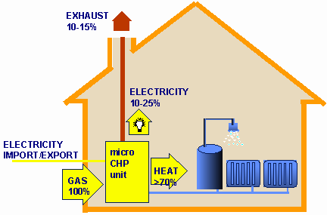
Micro-renewable energies
Micro-combined heat and power (micro‑CHP)

Slide 21
Micro-renewable energies
Micro-combined heat and power (micro‑CHP)
Benefits
When the micro-CHP is generating heat, the unit will also generate electricity to be used in the home (or exported).
By generating electricity on-site, the consumer could be saving carbon dioxide compared with using Grid electricity and a standard heating boiler.
Micro-CHP is eligible for feed-in tariffs. Please note that the feed-in tariff is not available in Northern Ireland.
For the householder, there is very little difference between a micro-CHP installation and a standard boiler. If the consumer already has a conventional boiler then a micro-CHP unit should be able to replace it, as it’s roughly the same size. However, the installer must be approved under the Microgeneration Certification Scheme (MCS).
Servicing costs and maintenance are estimated to be similar to those of a standard boiler – although a specialist will be required.

Slide 22
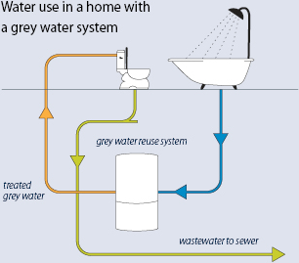
Micro-renewable energies
Greywater re-use

Slide 23
Unit 203: Electrical installations technology
The End

